Slide 1
Syllogism

Slide 2
Syllogism
SYLLOGISM
A syllogism is a logical argument where a quantified statement of a specific form (the conclusion) is inferred from two other quantified statements (the premises).
Types of statements:
There are four types of statements in syllogism
1. All
2. Some
3. No
4. Some not
These statements can be represented will the help of Venn diagram

Slide 3
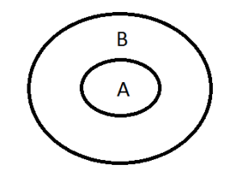
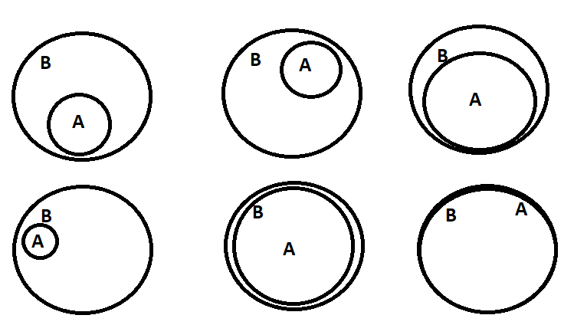
Syllogism
1.) All STATEMENT
All statement is written in the format “ALL A are B”, here A and B represent the subject and object of the statement.
Venn diagram

Slide 4
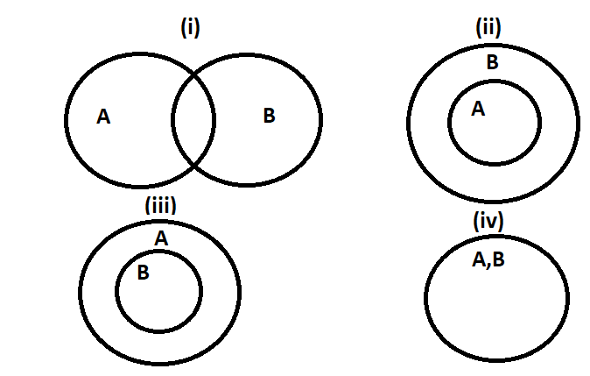
Syllogism
2.) SOME STATEMENT
Some statement is written in the format “Some A are B”, here A and B represent the subject and object of the statement.

Slide 5
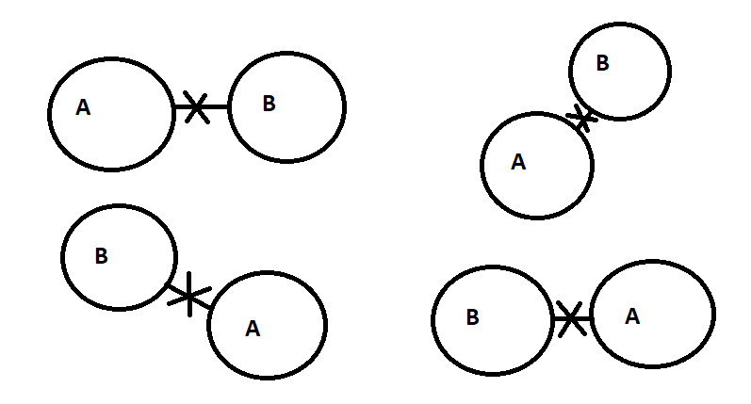
Syllogism
3.) NO STATEMENT
No statement is written in the format “No A are B”, here A and B represent the subject and object of the statement

Slide 6
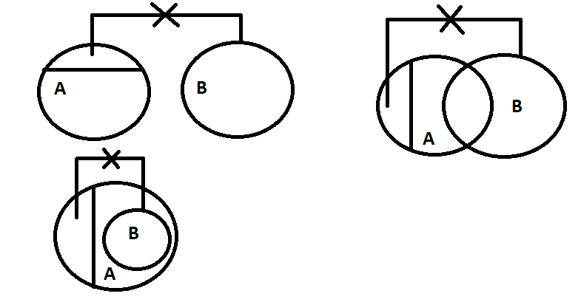
Syllogism
4.) SOME NOT STATEMENT
All statement is written in the format “Some A are not B”, here A and B represent the subject and object of the statement.

Slide 7
Syllogism

Slide 8
PROBLEMS BASED ON VENN DIAGRAM

Slide 9
Syllogism
Directions : In each of the following questions two statements are given and these statements are followed by two conclusions numbered (1) and (2). You have to take the given two statements to be true even if they seem to be at variance from commonly known facts. Read the conclusions and then decide which of the given conclusions logically follows from the two given statements, disregarding commonly known facts.
Give answer:
(A) If only (1) conclusion follows
(B) If only (2) conclusion follows
(C) If either (1) or (2) follows
(D) If neither (1) nor (2) follows and
(E) If both (1) and (2) follow.

Slide 10
Syllogism
Statements: Some kings are queens All queens are beautiful
Conclusions: 1. All kings are beautiful 11.All queens are kings
-CUBASTION CONSULTING PVT LTD
I follow b. I & II follow c. II follow d. neither follow
Notes:
Part –B-7th edition 23.1.2 qn-5 ans d

Slide 11
Syllogism
Statements : All the papers are books. All the bags are books. Some purses are bags. Conclusions : I. Some papers are bags. II. Some books are papers. III. Some books are purses. -SMARTPRIX WEB PVT LTD
A. Only (I)
B. Only (I) and (II)
C. Only (III)
D. both (II) and (III)
Notes:
Part B-7th edition 25.3.1 qn-1 ans is D

Slide 12
Syllogism
Statements: Some Cats are Rats. All bats are tables. All Rats are Bats. Conclusion:
I. Some Cats are bats
II. All bats are rats
III. All tables are cats
IV. All bats are cats
-KPIT
1. Only I & II follow
2. Only II follows
3. Only I & IV follow
4. None of these
Notes:
Ans is 4

Slide 13
Syllogism
Statements: Some ships are boats. All boats are submarines. Some submarines are yatches. Conclusion:
I. Some yatches are boats.
II. Some submarines are boats.
III. Some submarines are ships.
IV. Some yatches are ships
-KPIT
1. All follow
2. Only II and III follow
3. Only III follows
4. Only IV follows
Notes:
Ans is 2.

Slide 14
Syllogism
Statements: Most CPUs are keyboards. No keyboard is a Mouse. All Mouses are CPU. Conclusion:
I. Some keyboards are CPU
II. All CPU’s are Mouse
III. No Mouse is a keyboard
IV. Some Mouse are keyboard
-CHC CONSULTING
1. Only I follows
2. Only II and III follow
3. Only I and III follow
4. Only II follows
Notes:
Ans is 3.

Slide 15
Syllogism
Statements: I. Some cars can fly. II. Rama is a car.
Conclusions: I. Rama can fly. II. Rama cannot fly. III. Rama can dance. IV. Rama can swim.
-SMARTPRIX WEB PVT LTD
a. All I,II,III and IV follows c. either I or II b. only I follow d. none of these
Notes:
Ans is C 25.3.1 part –B-7th edition qn 2

Slide 16
Syllogism
Statements: Some cows are camels. All camels are buffaloes. No buffalo is a fox.
Conclusions : Some camels are foxes. No buffalo is a cow. No cow is a fox.
-GRAZITTI INTERACTIVE LLP
(A) If only (1) conclusion follows
(B) If only (2) conclusion follows
(C) If either (1) or (2) follows
(D) If neither (1) nor (2) follows and
(E) None follows
Notes:
Ans is E part C-4th edition 179.2.3 qn 2

Slide 17
Syllogism
Statement: All pens are books No pencils are books
Conclusion: 1. All books are pencils 2. All pencils are books 3. Some pencils are books 4. None
-EMERSON INFORMATION TECHNOLOGY
Notes:
Ans is 4 65.1.2 part B-7th edition

Slide 18
PROBLEMS BASED ON EITHER-OR CASE

Slide 19
Syllogism
Statements: I. Some papers are pens II. Angle is a pen
Conclusions: 1. Angle is not a pen
2. Angle is a pen
-L&T INFOTECH
A. Only conclusion I follows
B. Only conclusion II follows
C. Either I or II follows
D. Neither I nor II follows
E. Both I and II follow
Notes:
Part B-7th edition qn C-62.1.2

Slide 20
Syllogism
Statements: Some paints are shoes. Some shoes are sleepers. All sleepers are shirts. Conclusions: At least some shirts are paints. No shirt is a paint.
-GRAZITTI INTERACTIVE LLP
(A) If only (1) conclusion follows
(B) If only (2) conclusion follows
(C) If either (1) or (2) follows
(D) If neither (1) nor (2) follows and
(E) If both (1) and (2) follow.
Notes:
Ans is C part C-4th edition 179.2.3 qn 17

Slide 21
PROBLEMS BASED ON POSSIBILITY

Slide 22
Syllogism
Statements: All engineers are villagers. No villager is a nurse. All nurses are managers. Conclusions: No engineer is a manager. All villagers being managers is a possibility
-GRAZITTI INTERACTIVE LLP
(A) If only (1) conclusion follows
(B) If only (2) conclusion follows
(C) If either (1) or (2) follows
(D) If neither (1) nor (2) follows and
(E) If both (1) and (2) follow.
Notes:
Ans is B part C-4th edition 179.2.3 qn 16

Slide 23
Syllogism
Statements: Some chairs are desks. No desk is a bench. Some tables are chairs
Conclusions: All benches being tables possibility. At least some desks are tables.
-GRAZITTI INTERACTIVE LLP
(A) If only (1) conclusion follows
(B) If only (2) conclusion follows
(C) If either (1) or (2) follows
(D) If neither (1) nor (2) follows and
(E) If both (1) and (2) follow.
Notes:
Ans is A part C-4th edition/
179.2.3 qn 1

Slide 24
Syllogism
Any Doubts???
Notes:
Option A
Easy (Optional)

